Slide 1
A Pleasant Development Environment featuring Docker and Rails
Chris Cumming

Slide 2

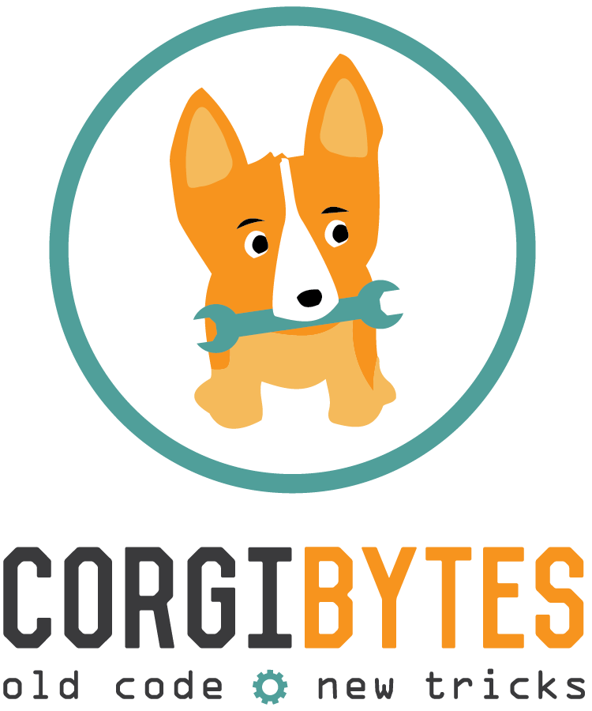
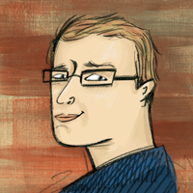
Who am I? (i.e. Shameless Self Promotion)
Software Consultant http://nftb.saturdaymp.com https://corgibytes.com/ chris.cumming@satudaymp.com @corgibytes @saturdaymp Chris C on Dev Edmonton Slack Chris C on Legacy Code Rocks Slack

Slide 3
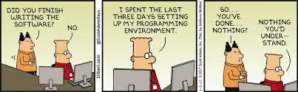
What is a Development Environment?
Notes:
For our discussion a development environment is where code is written. It’s not a separate shared environment like staging or production. It is something everyone has even if you put no thought into it. It’s everything you did on your local workstation to get the application/website to run. From checking out the code to being able to running your app to test your bug fix or new feature.
The only thing we won’t include in this discussion is your IDE. An IDE is part of your development environment but I like to leave the IDE up to each individual.

Slide 4
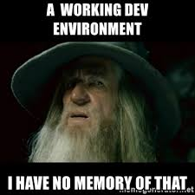
History of my Development Environments
Oral tradition
Documentation
Good defaults in source control
Including libraries in source control (no longer do this)
Scripts
Virtual machines
Docker
Notes:
When I first started as a developer the first development environments I setup where done with the help of another developer telling me what to install. Then trying to find the MSDN CD. The case was usually easy to find but finding that one CD was a bit of problem. It was usually in someone else’s CD drive.
Occasionally there was a ReadMe, or similar file. It was around this time that I started adding my own documentation for setting up development environments.
The next thing I started doing was adding good development defaults in source control. For example if you have a config file then set it up so it points to the development database. In my early years this was a shared development DB not on my local workstation.
Next I started including 3rd party libraries and installers in source control. For example, if you needed certain ActiveX control or a version of C++ runtime you could find it in source control. I stopped doing this but sometimes you will still see this done by companies having on-site NuGet or RubyGems servers.

Slide 5

What Makes a Development Environment Pleasant?
Good defaults
Documented & Automated
Easy to reproduce/portable
Versioned
Self contained
Close to production as possible
Notes:
First the it should have good defaults when checked out for the first time. For example, if you have a config file then make sure it has values for development such as your localhost DB. Of course it should go without saying don’t put sensitive information in source control. You still might have to manually set some passwords or API keys.
Second it should be documented AND automated. Be kind and outline how to setup your development. Don’t make the developer guess. How many times have you seen:
Clone
Run some outdated command that does not work
Run the app
The only thing better then documentation is pictures. Actually automation. Docker does a great job of automating the setup. If you aren’t using Docker then any scripts or other tools you can use to automate as much of the setup as possible would be greatly appreciated by your fellow developer. Of course you documented how to run the scripts right?
Third, the environment should be easy to reproduce on another developers machines. My development environment should match yours as close as possible. I should have the same version of Ruby as you. The same non-gem libraries versions. Use the same database version. You get the idea.
Fourth and finally the environment should match production as much as possible. If production is Ubuntu 18.04, Ruby 2.5, ImageMagick 7, and Postgres 11.3 then my development environment should be the same. At least as close as possible. An example of this recently created a development environment for MySQL 7. Unfortunately production was 5.6 which lead to some confusion when testing updating the database to utf8mtb4.

Slide 6
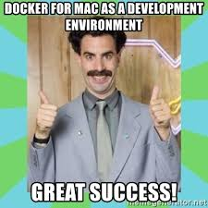
What is Docker?
A container is a standard unit of software that packages up code and all its dependencies so the application runs quickly and reliably from one computing environment to another. A Docker container image is a lightweight, standalone, executable package of software that includes everything needed to run an application: code, runtime, system tools, system libraries and settings.
https://www.docker.com/resources/what-container
Notes:
For our discussion I like to think of Docker as an installer for development environment. Summerize image vs container. Summerize differences between development and production.

Slide 7
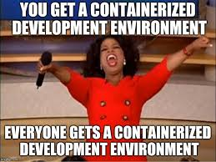
Why use Docker?
Best tool to meet all the Good Development Environment requirements.
Notes:
You still need to add good developer defaults but Docker allows for the other:
Automated
Reproducible and portable
Versioned
Self contained
Close to production

Slide 8
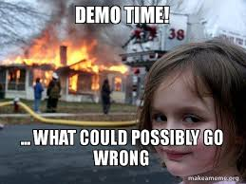
Demo Time
Options:
Setup new Rails app in Docker?
Dockerize an existing application?
Notes:
First review my Docker setup for the Rails template. Then either create a Docker setup for a new Rails app or Dockerize someone’s existing app.

Slide 9
Learn More
Rails Template https://github.com/saturdaymp-examples/rails-template
Quickstart: Compose and Rails https://docs.docker.com/compose/rails/
Follow up Questions chris.cumming@satudaymp.com Chris C on Dev Edmonton Slack @saturdaymp Chris C on Legacy Code Rocks Slack

